Slide 1




By: Mohammad Ahsan, Muhammad Talha, Zeyad Ahmed
z

Slide 2

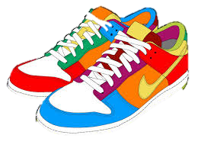
Motivation
z
Untapped Market
Growing Market
Long term investment

Slide 3
Organization & Flow
Navigation Bar
Pages
Landing page
About Us page
Collection page
History page
Cart page
Form Page

Slide 4
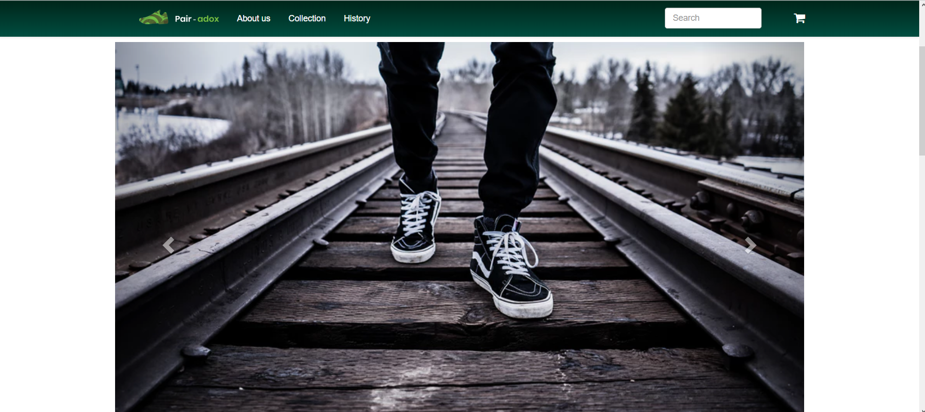
Landing page

Slide 5
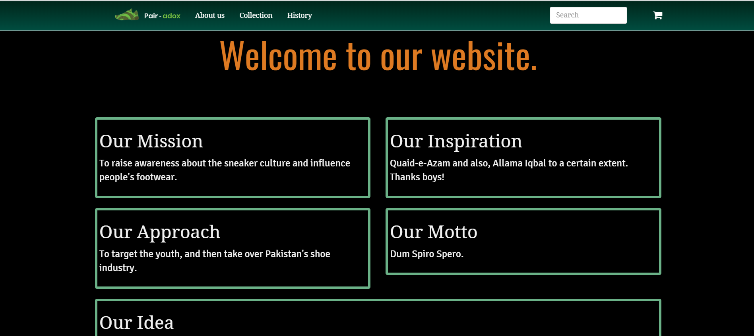
About Us page

Slide 6
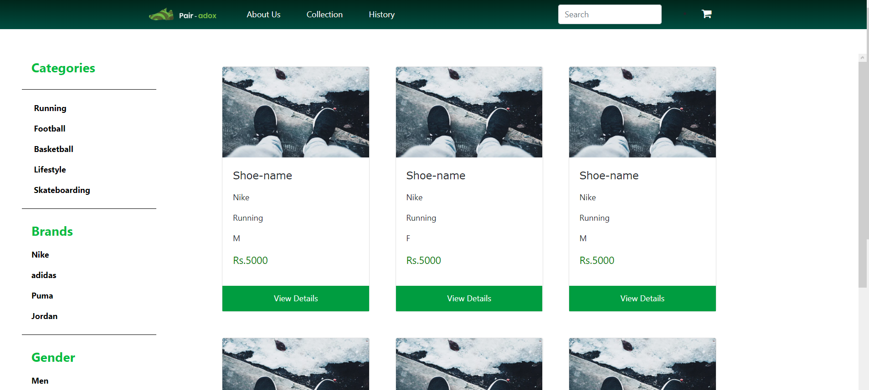
Collection page

Slide 7
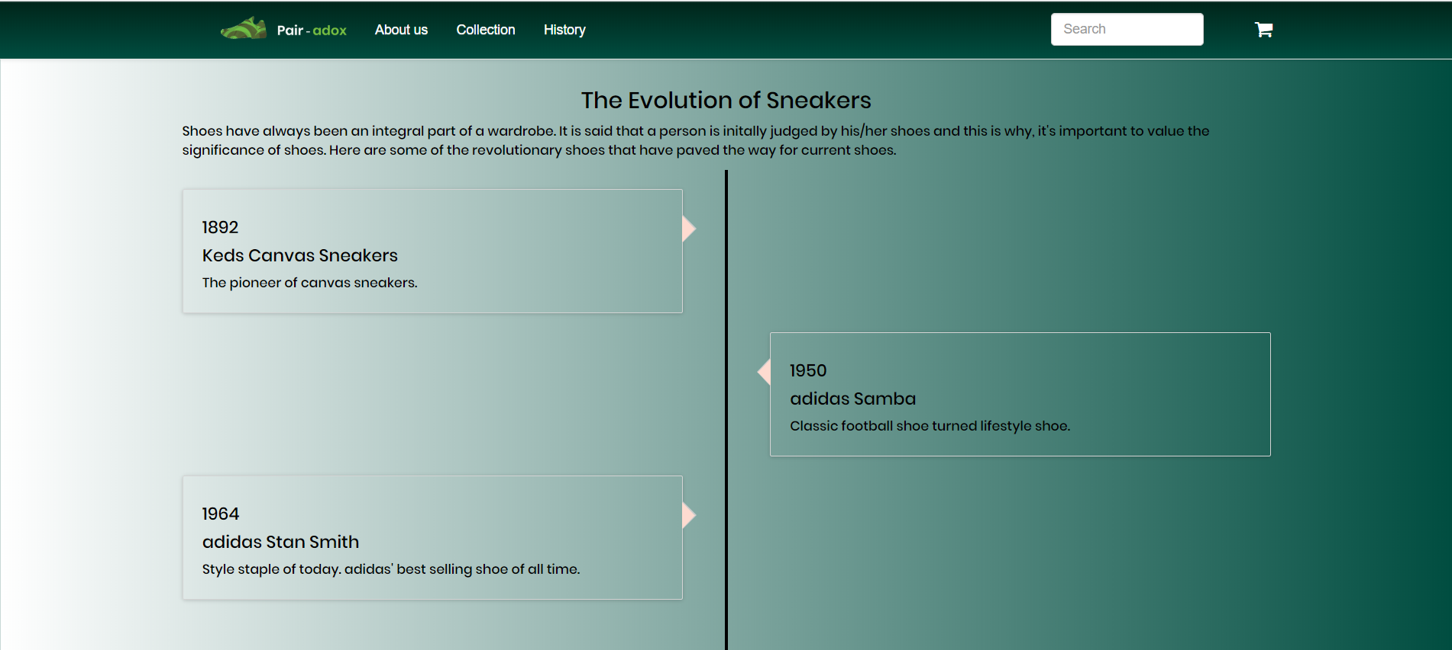
History page

Slide 8
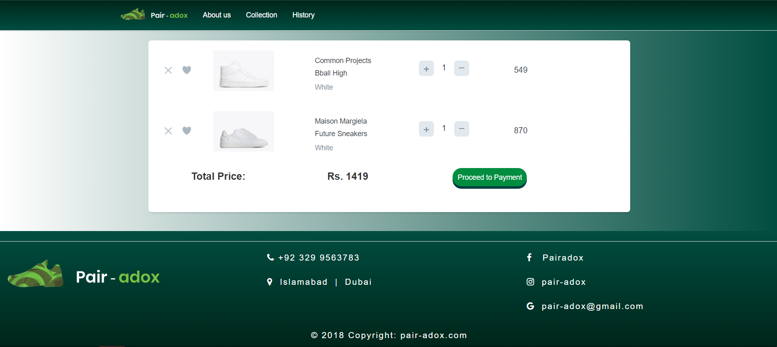
Cart page

Slide 9
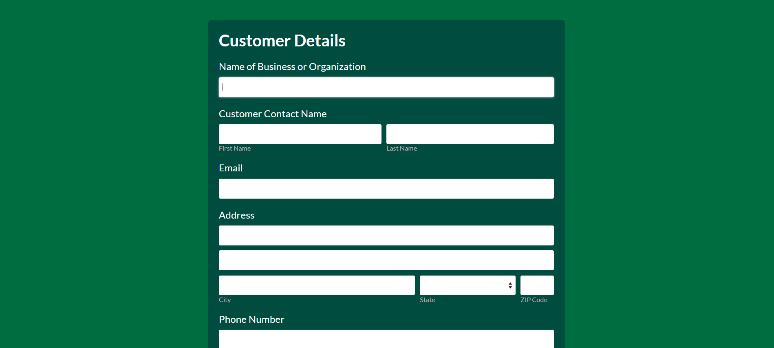
Form page

Slide 10
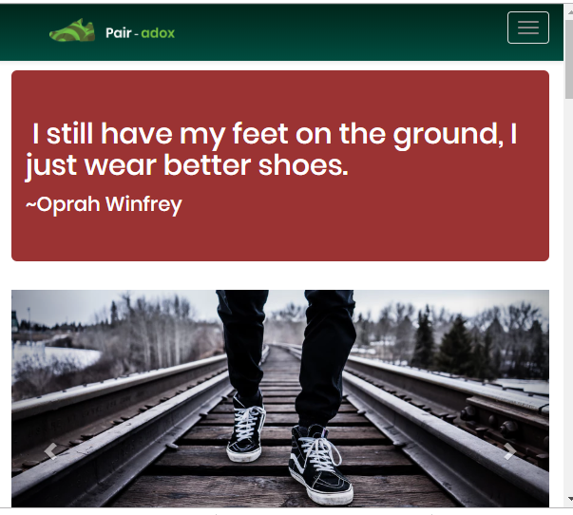
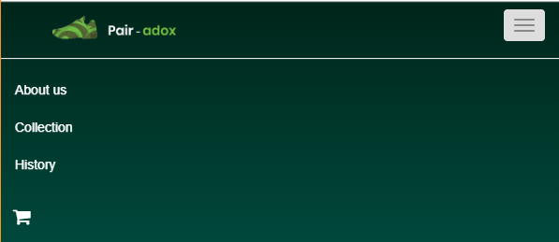
Responsiveness

Slide 11







Technologies Used
Comparison with existing systems
Pair-adox | Existing System
Clean interface | Relatively complicated
Simple filtering of shoes | Filters aren’t structured
New technologies used | Rely on outdated technologies

Slide 12
Problems faced
Work Division
Deciding on what technologies to use
Version Control
Backend Integration
Image storing in database
Responsiveness
HTML to PHP conversion decision

Slide 13
Roles
Talha | Ahsan | Zeyad
Basic structure and designing of each page | Designing and responsiveness of each page | Integrating backend with the frontend and database management
Add on knowledge
Google is a man’s best friend
HTML is very detailed
Cloud is very useful

